Slide 1
Introduction to JavaScript
Interactive Media
Unit 1

Slide 2
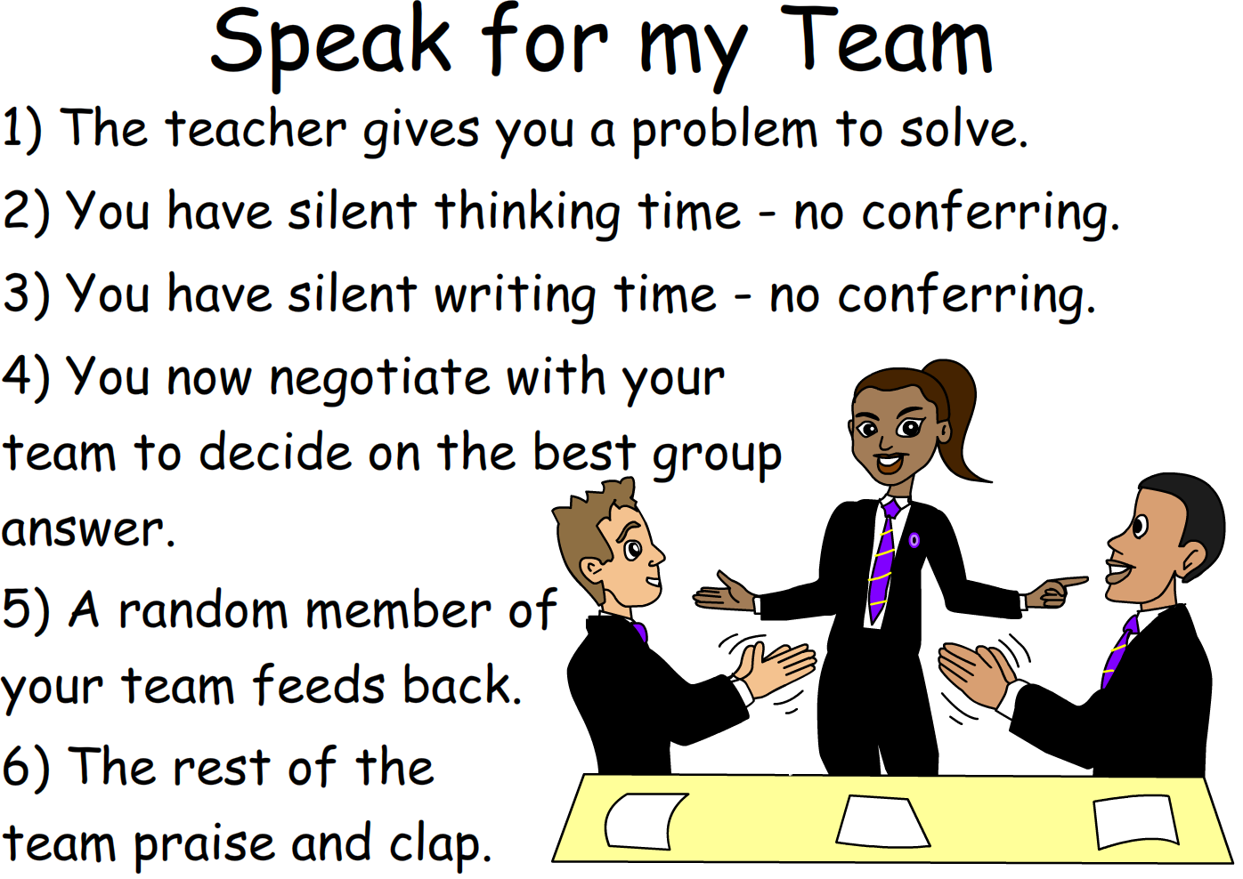
Starter – 5 Minutes
Log in and fill your answers into your worksheet.
What is the purpose of CSS when used with an HTML webpage?

Slide 3

Learning Outcomes
Aspire to ……
 | Explain in practice how to effectively use JavaScript to improve a webpage.
Challenge to……
 | Describe the different ways JavaScript can be used.
 | Understand the purpose of adding JavaScript elements to an HTML page.

Slide 4

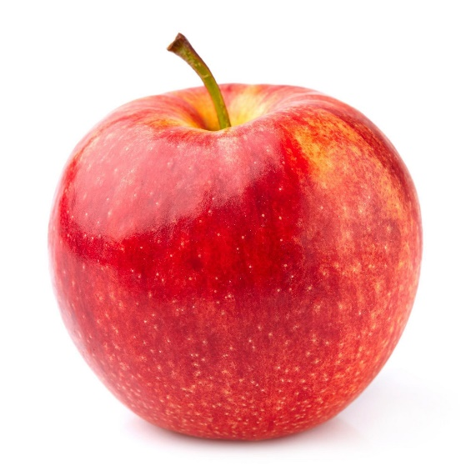
JavaScript and Java
Although it shares a similar name to Java, JavaScript is completely unrelated.
They are about as similar as these two:

Slide 5
What is JavaScript
JavaScript is a programming language, previously known as Mocha, then LiveScript, now JavaScript.
JavaScript is used to dynamically change elements within an HTML document.
This can allow parts of the page to change depending on the user’s input.
Is there a term for a product where the output reacts to the user’s input?

Slide 6
Using JavaScript
As with CSS, JavaScript can be used as an external document or inline.
What is meant by the term inline?
To keep your work organised and manageable, you will be shown how to create and link an external .js file to your HTML document.

Slide 7


Task 1 – How Does it Work?
Take a look at the following example of JavaScript code, answer the questions below about it.
What do you think the innerHTML = part does?
What does it all do in combination?
What do you think the getElementById part does?
What do you think the first line does?
Challenge D

Slide 8
JavaScript Example
The example of code below is the basis of what you will be using for your webpages.
Tells us that it is a function called myFunction.
Looks in the document (HTML page) for an element with the ID title.
Sets the inner HTML value (the text) to New Title.

Slide 9
Calling the JavaScript
To access JavaScript from another file, you need to use the script tag in HTML.
The following code tells the HTML document that myScript.js (the JavaScript file) contains code, so to look there whenever looking for a function.

Slide 10
Accessing the Functions
There are various methods of accessing the functions within a JavaScript file which will vary depending on what you want it to do.
You need to define when the function is called to access it.
In the following example, a button with the text Try it will call the function onclick (when the button is pressed).

Slide 11
Task 2 – Experimenting with JavaScript
You have been provided with a sample website that has basic JavaScript elements added to it.
Create another function in the JavaScript file.
Call that function within the HTML file.
Modify which element the function accesses.
Experiment with the site; change the text in the functions.
Challenge D

Slide 12
Homework
You have been given access to two “Cheat Sheets”.
One contains information about common tags in HTML, the other contains common CSS and JavaScript code.
Read the document/website to prepare for the following lesson, you will be using HTML, CSS and JavaScript together.

